Slide 1
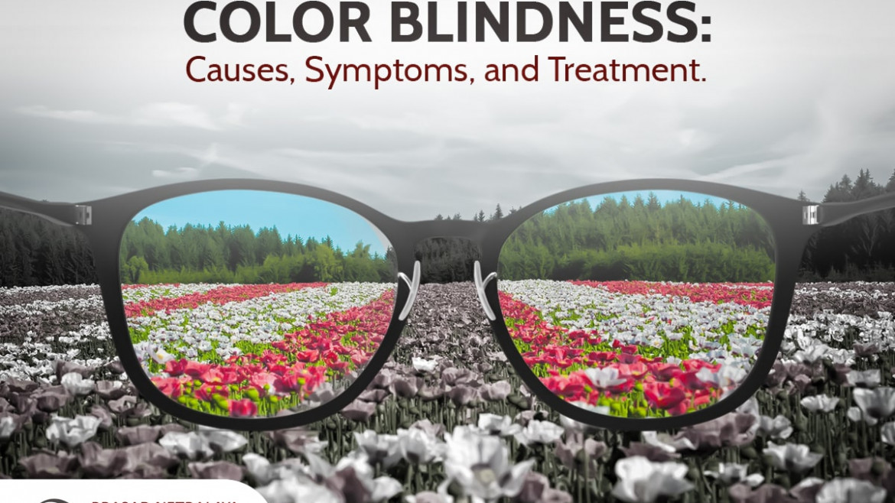

Slide 2
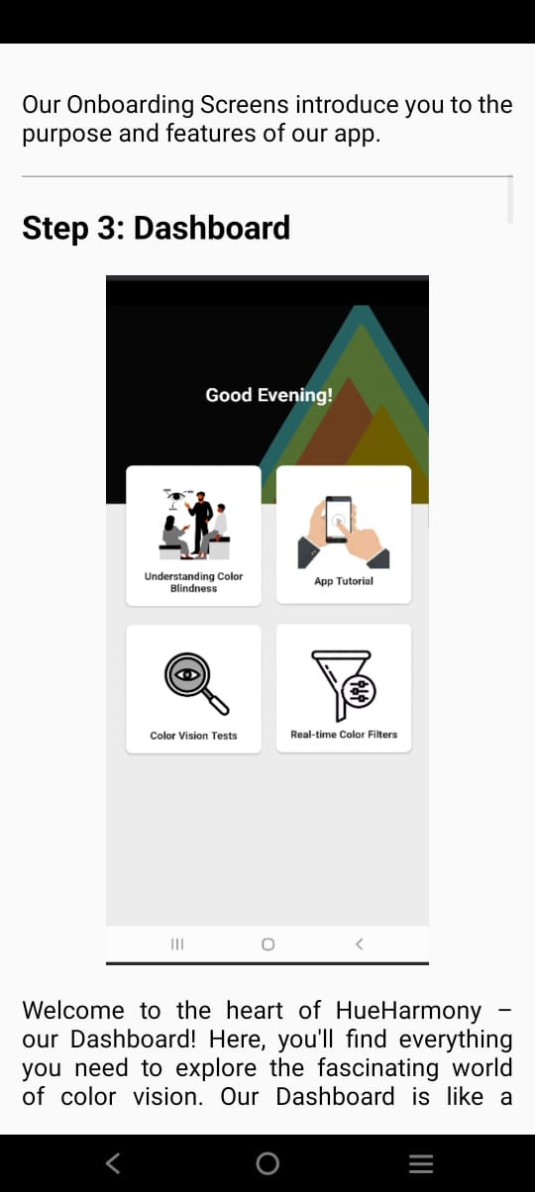
Functionality of HueHarmony
Features:
Understanding color blindness
App tutorial
Color vision tests
Real time Color Filters

Slide 3
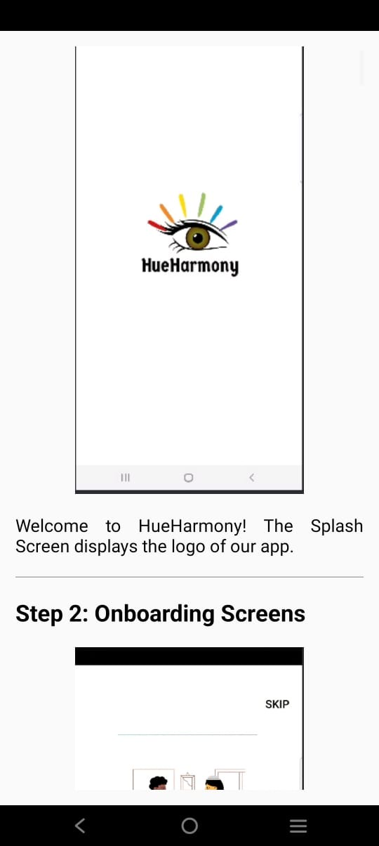
Understanding Color Blindness
Color blindness, also known as color vision deficiency (CVD), is a condition that makes it difficult to see or differentiate colors.
It can range from a minor inconvenience to a complete inability to see color.
There are three types- red, blue and green.

Slide 4
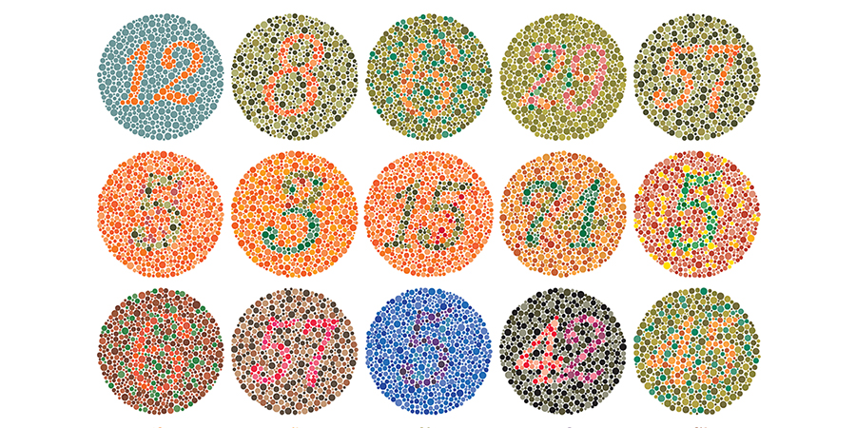
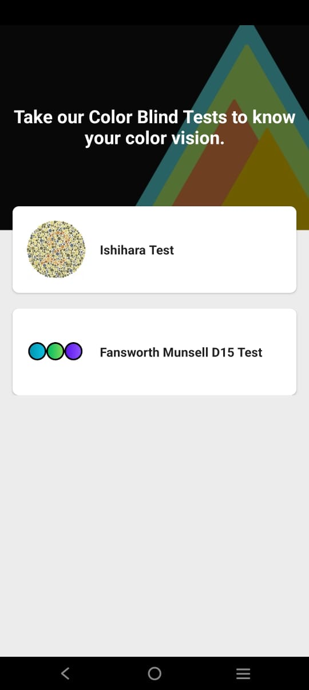
Ishihara Test
You have to enter the number(s) for each plate you can see. If you don't see anything just click to the next button. There will be 12 plates , the results will be stored in pdf format in your devices.

Slide 6
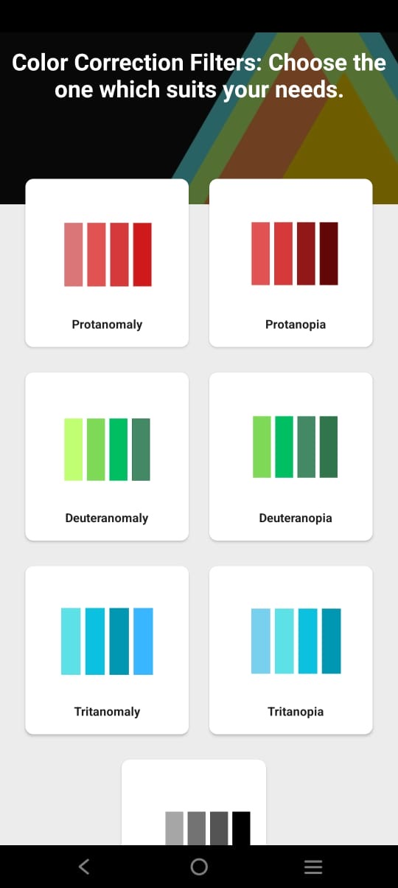
Real time color Filters
You can open the camera and point to the objects which displays the respective colors.

Slide 7
See the world in different light

